Slide 1

Computer Vision Project
Two-View Depth Estimation
Group No: 48
Team Members:
Anshak Goel (2020283)
Sahil Goyal (2020326)
Deeptorshi Mondal (2020294)

Slide 2
Problem Statement
Dataset Description and Demonstration
Methodology
Results and Analysis
Individual Contributions
Contents

Slide 3
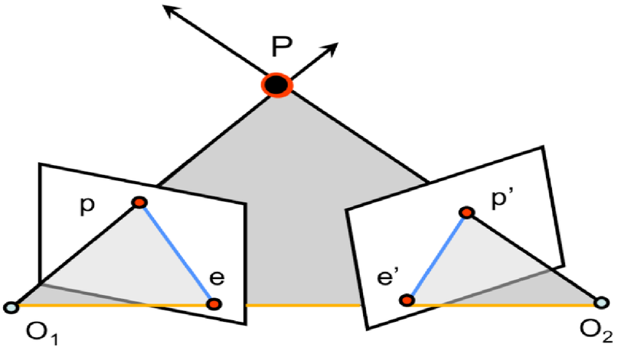
Problem Statement
Our primary goal is executing, evaluating, and potentially enhancing the depth estimation process by combining frame rectification and triangulation techniques using epipolar geometry. Our aim is to improve the precision and dependability of depth estimation in different situations. We have to use multiple images of the same overlapping view to estimate the depth of a scene point from image points in the camera coordinate frame of reference, and using the depth of those points, we have to create a depth map that estimates the depth of a point in the scene.

Slide 4
Dataset Description and Demonstration
We have clicked photos of the IIITD campus using our mobile phones. We have clicked multiple images of the same view from different positions and angles. We have tried to take pictures of ideas with texture so that SIFT detector works well.
We have also taken some images from the Middlebury Dataset containing images of different scenarios with texture.
We will use these photos as stereo-pairs from our dataset for two-view depth estimation.

Slide 5
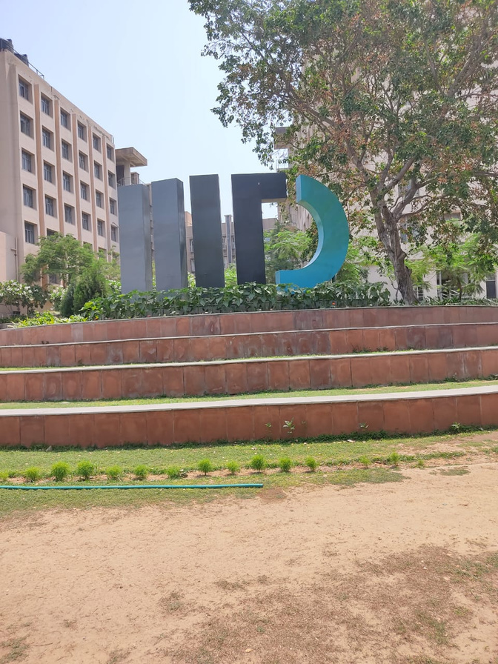
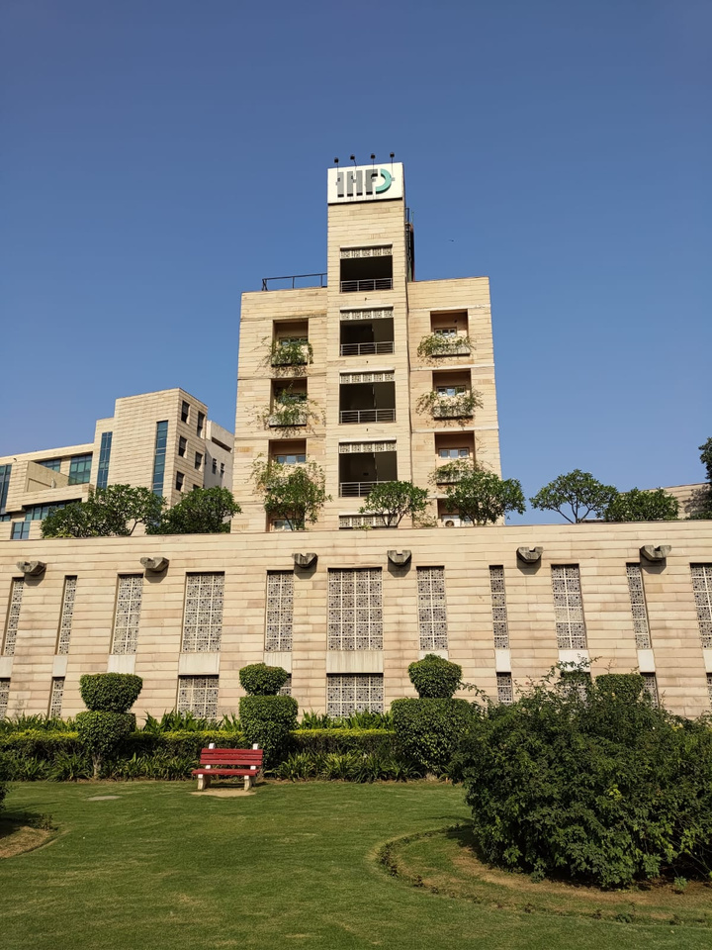
Some examples of the data
These are images we took manually within the IIIT campus

Slide 6
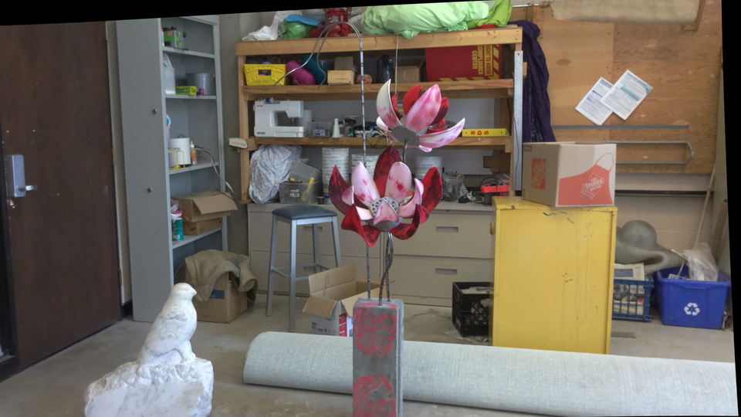
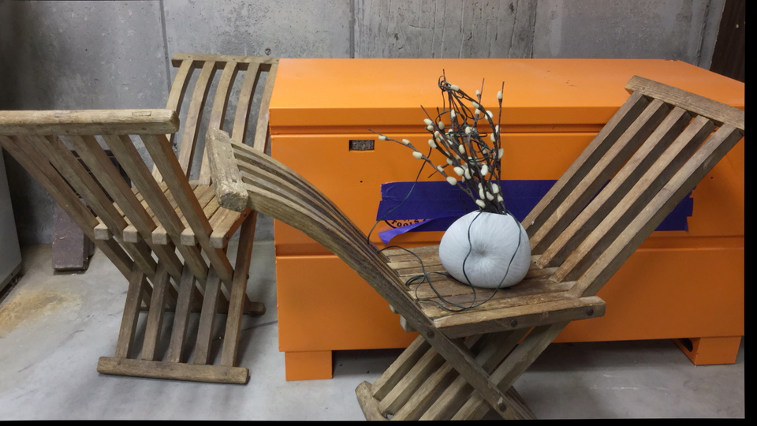
Some examples of the data
These are images we took from the Middlebury dataset

Slide 7
Methodology
We will open the two images and read them as grayscale images.
We use the SIFT_create() function to compute the SIFT key points and descriptors for both images.
We use the Brute Force Matcher of the OpenCV library (cv.BFMatcher) and match the key points between the two images. Then we filter them based on the distance ratio and only keep the better matches.
We use cv.findfundamentalmatrix() to find the fundamental matrix. This describes the geometric relationship between the two camera views.

Slide 8
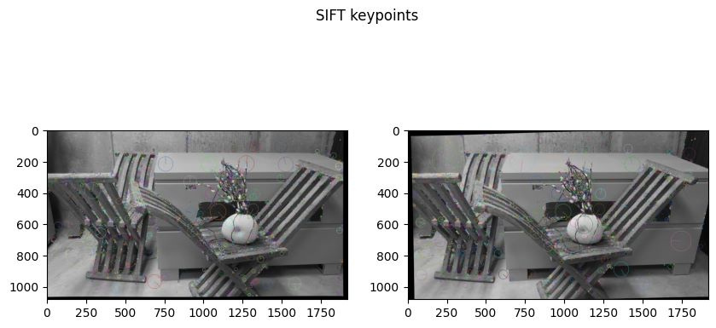
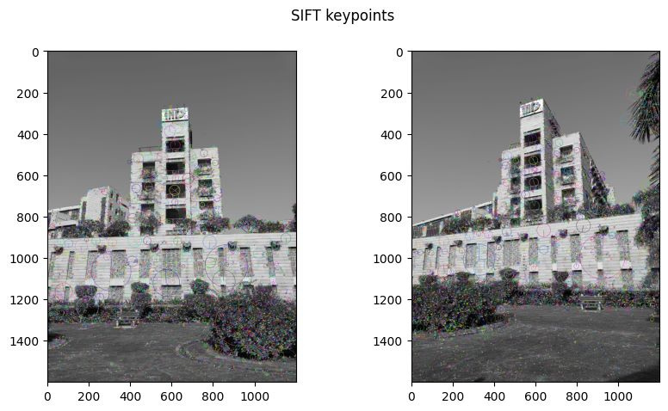
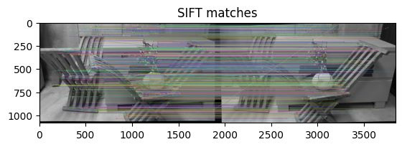
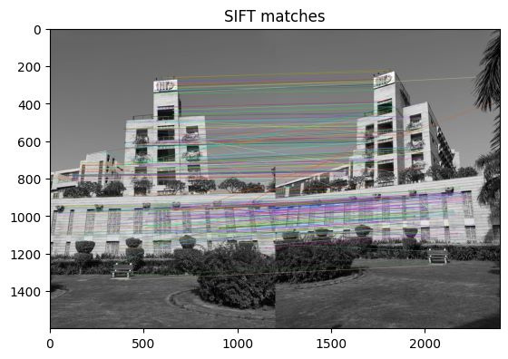

Slide 9
Methodology
We find the essential matrix using the fundamental matrix and the camera intrinsic parameter matrix.
We have also retrieved the R,t that describes the relationship between two camera poses using the SVD decomposition of the Essential matrix.
We use the cv.stereoRectifyUncalibrated() and steroRectify() functions to find the rectification transforms for the images based on the fundamental matrix. We then warp the images to obtain the rectified images.
We use the StereoSGBM algorithm to get the disparity map from the rectified images. It takes parameters like maximum, minimum disparity, block size, etc. We then normalize the depth map and display it.

Slide 10
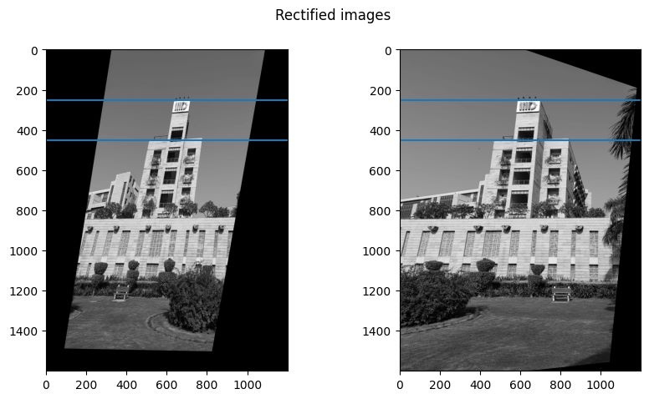
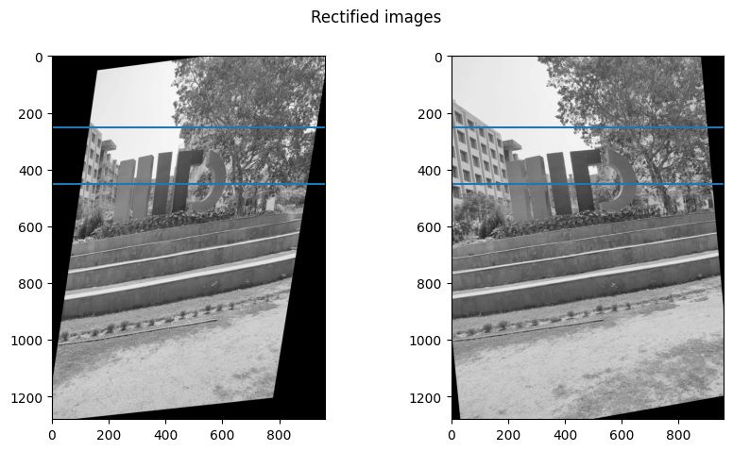
Rectified Images
The horizontal lines have the same y-coordinate in both images and show that after rectification, they pass through the exact same location in the image.

Slide 11
Methodology 2
We have also used a pre-trained MIDAS model to estimate depth from input images. It processes each image and applies a depth estimation model, and we saved the depth maps.
It is trained on labeled and unlabeled data to understand the relationship between image features and depth. The model utilizes this data to make depth maps from single images, correctly capturing the 3D structure.
Deep learning gives more accurate results than the geometric approach for most of the images.

Slide 12
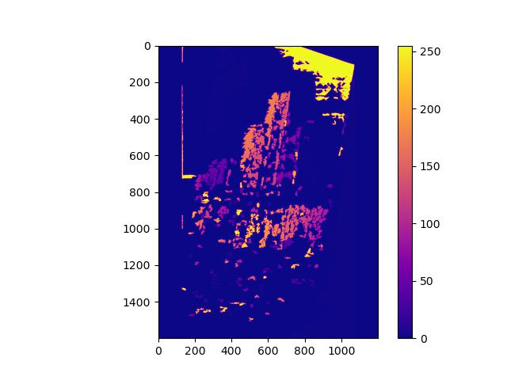
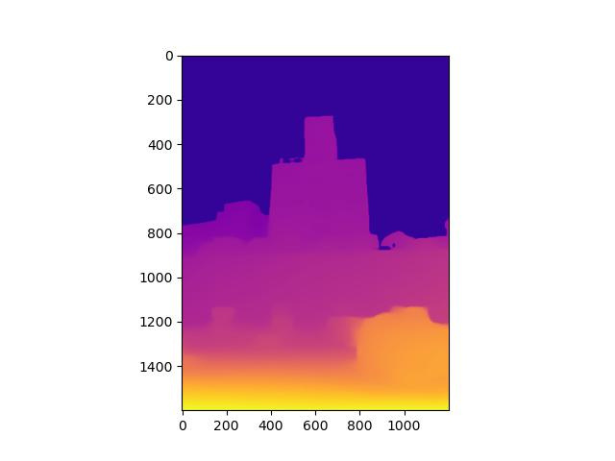
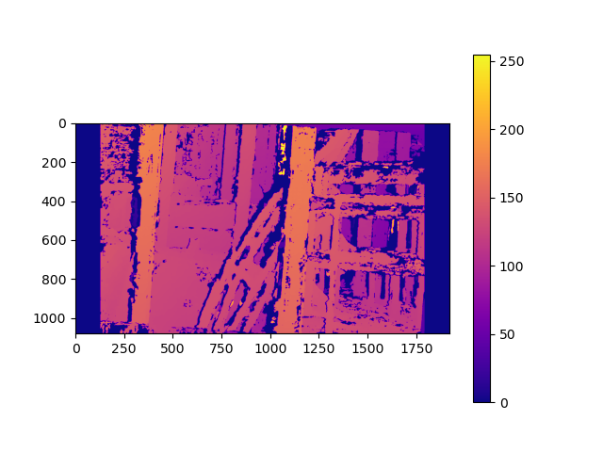
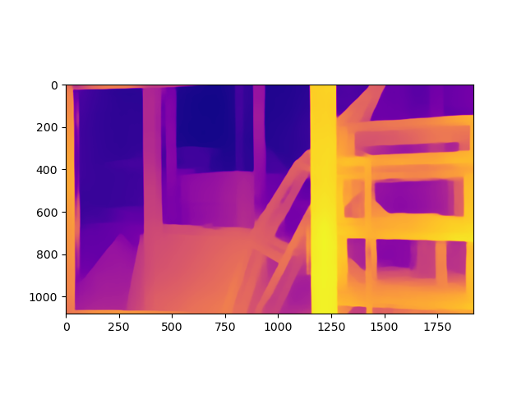
Comparison between the two methods

Slide 13
Methodology 2
We have tried some variations in our approach. We tried to run the code on both simple and uncalibrated stereo.
We have also tried to retrieve the homography matrics using findRectification() and findRectificationUncalibrated()
We have also used Brute Force and FLANN matcher to find matches, as Brute Force was giving better matches, so we kept that.
To estimate the Fundamental matrix, we used 8-point estimation and the RANSAC approach as Ransac gave better results, so we kept that.

Slide 14
Results and Analysis
These are the depth maps we obtained. To compare the depth maps, we have first shown the original image, then the depth map we got using two view depth estimation, and then the depth map we got from the deep learning model.
We can see that the depth map we get from the deep learning model is more accurate than the one from Two view depth estimation.
We can see that images with more texture and key points give better disparity maps in two-view depth estimation than other image pairs.

Slide 15
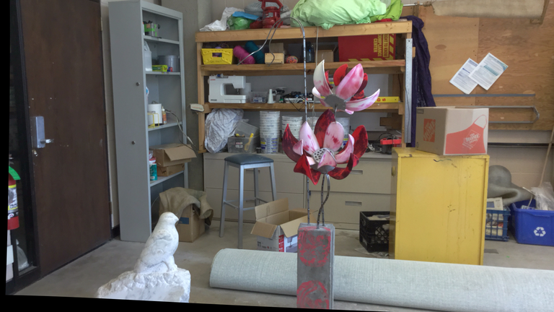
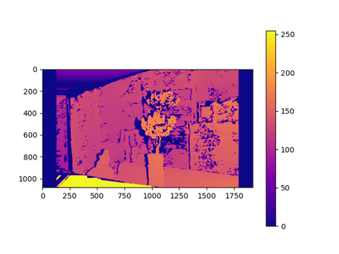
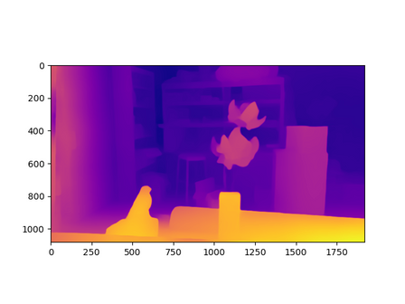
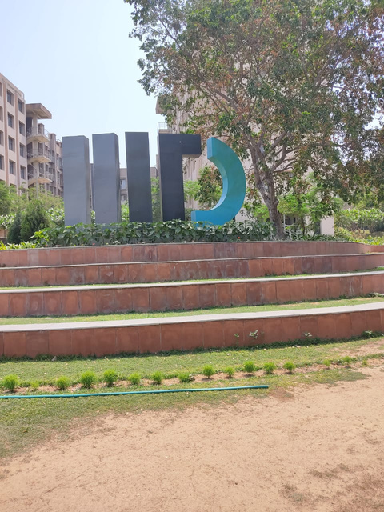
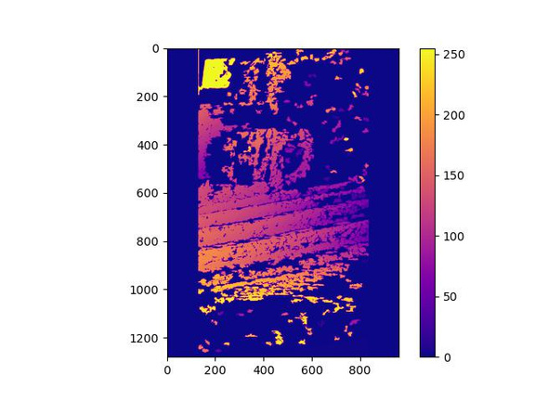
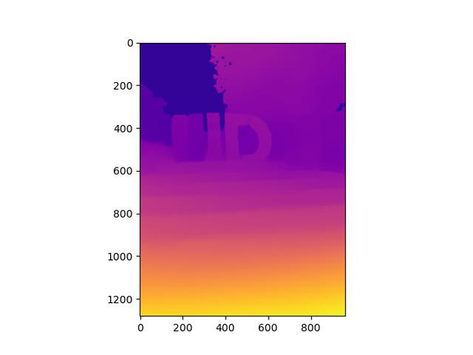
RESULTS
IMAGES USED
DISPARITY MAP(CV)
DISPARITY MAP(DL)

Slide 16
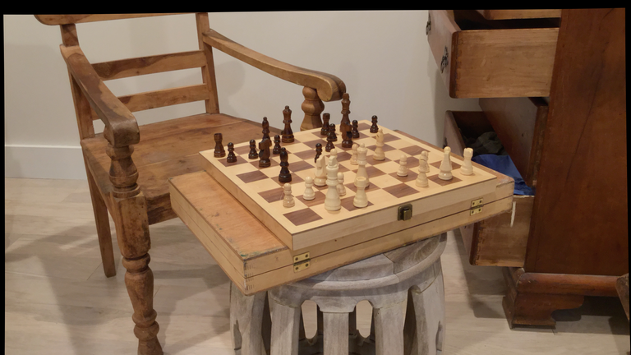
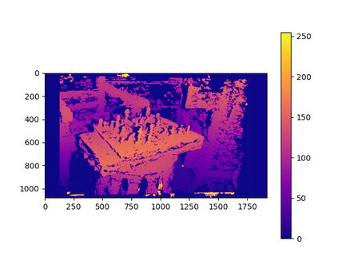
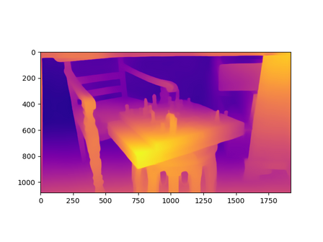

RESULTS
IMAGES USED
DISPARITY MAP (CV)
DISPARITY MAP(DL)

Slide 17
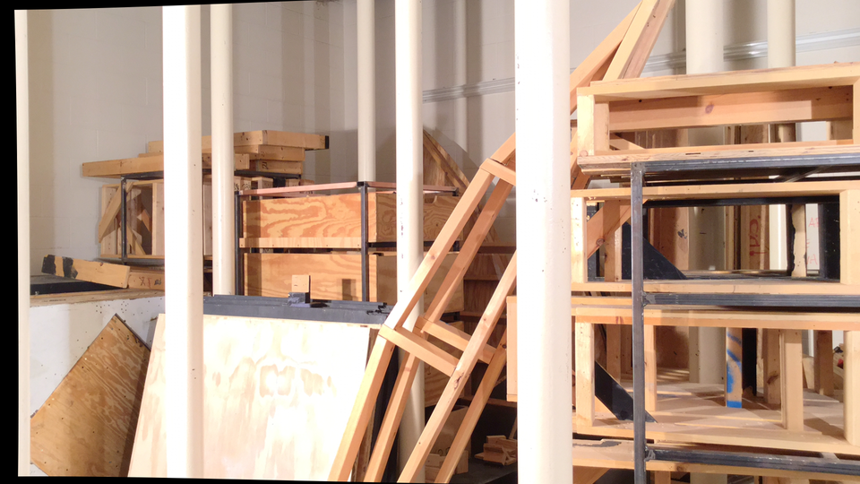
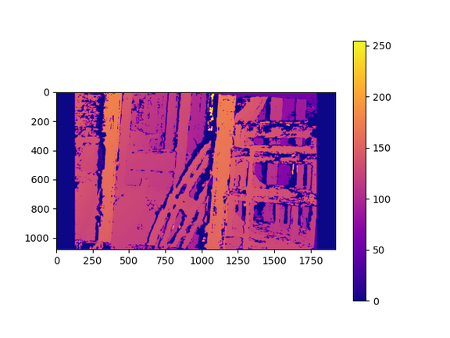
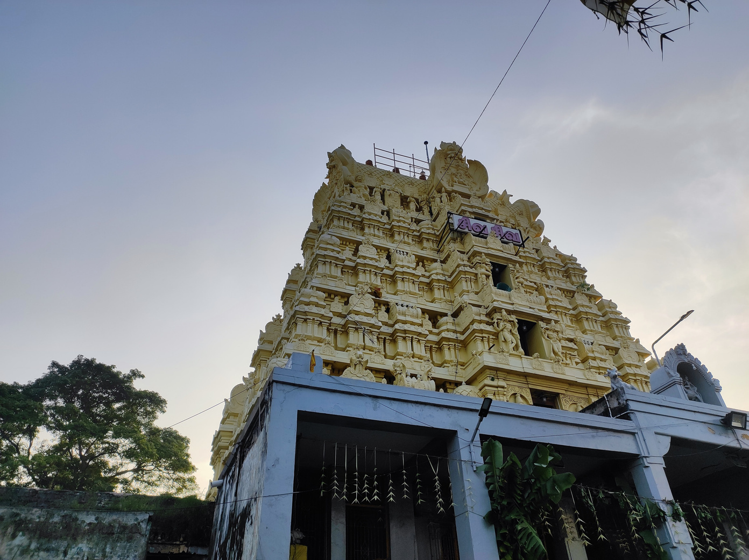
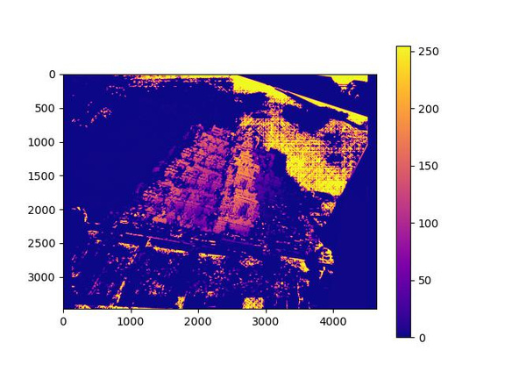
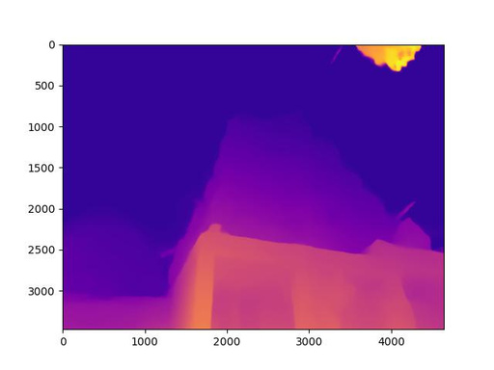
RESULTS
DISPARITY MAP (CV)
IMAGES USED
DISPARITY MAP(DL)

Slide 18
Results and Analysis
The more the angle and position vary, the worse the depth map we get in two-view depth estimation. This is because the overlapping area also reduces with the change in position and angle.
When we only shift the camera horizontally, we get a better result compared to when we also change the angle. This is because rectification is more difficult in the second case compared to the first one.

Slide 19
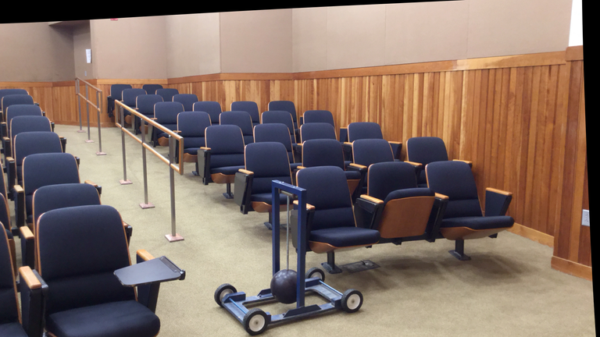
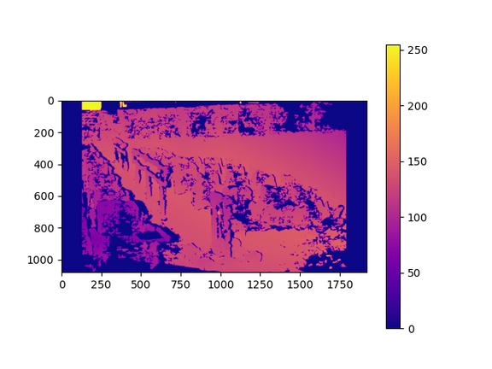
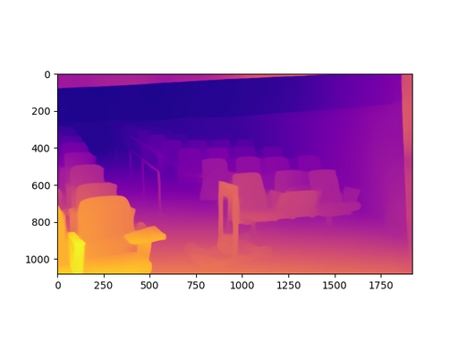
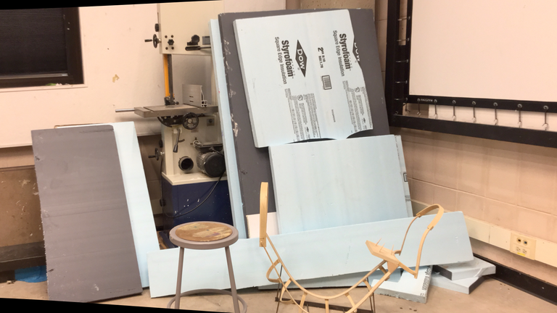
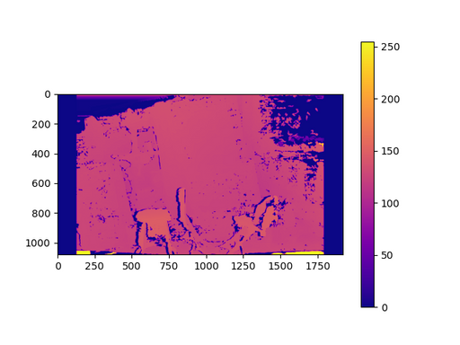
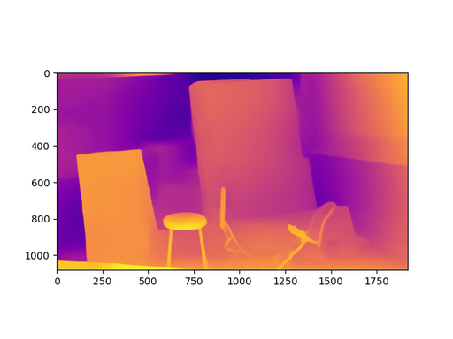
FAILED CASES
IMAGES USED
DISPARITY MAP(CV)
DISPARITY MAP (CV)

Slide 20
Analysis of Failure
There are also failed cases. For example, in the image of the hall filled with chairs, the disparity map could be of better quality.
This is because all the chairs are the same colour, and the pattern is repetitive. There is little texture, and whatever texture we find, we can see that it is repeated in the image, because of which proper matching between key points is complex.

Slide 21
Individual Contributions
Anshak Goel | Computer Vision Code,Testing the Code, Triangulation Method, Epipolar Geometry and Presentation
Sahil Goyal | Deep Learning Approach and Dataset Collection and Presentation
Deeptorshi Mondal | Computer Vision Code, Testing the Code, Triangulation Method, Epipolar Geometry and Presentation

Slide 22


